Slide 1
What are the key steps to optimize processes for digital transformation?
AIIM True North 23 March 2022
Shyamal Addanki
shyamal@silvermistconsulting.com
Notes:
Using process risk analysis to determine the starting point of digital transformation.
Wow, this is a mouthful of a title. If you’re interested in such a title, you’re in the right place.
What I want to talk about for the next 35 minutes is about process risk analysis as a concept – but this is just a high level overview and a starting point for you to think about it.
Let’s start by looking at the why – why would you need to do this? (Next slide)

Slide 2
Just imagine….
Which process would you choose for the proof-of-concept?
You are given a 15K budget for a POC to explore new technology for improving process efficiency.
If the project is successful, the company will roll out the method globally – it is in your hands.
You attend a conference and speak with BPM, RPA, AI and other digital tool vendors who can do a proof-of-concept project.
Notes:
Think about your own company and which process you would choose in this scenario. And think about why you chose it.

Slide 3
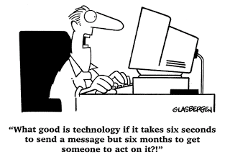
Common reasons for selecting a PoC process.
The process that creates the most problems. (quality, rework, customer complaints)
The process that internal users complain about. (whining around the watercooler)
The process that really annoys you. (I hate filing expense reports, I wish we could do something about that)

Slide 4
Instead, use PRA to find the right process.
What is process risk analysis (PRA)?
A way to understand and visualize issues in the process landscape.
A way to understand how failures and risks impact the business.
Notes:
PRA helps you look at your process issues at a macro level – not just at each process but the overall landscape.
PRA forces you to analyse your process and see how well they align with the business.

Slide 5
Instead, use PRA to find the right process.
Are your processes aligned with the company’s operations?
A way to understand and visualize issues in the process landscape.
Are your processes aligned with the company’s strategy?
A way to understand how failures and risks impact the business.
Notes:
Another way to think about is how well your processes are aligned with your company’s OPERATIONS and with your company’s STRATEGY.

Slide 6
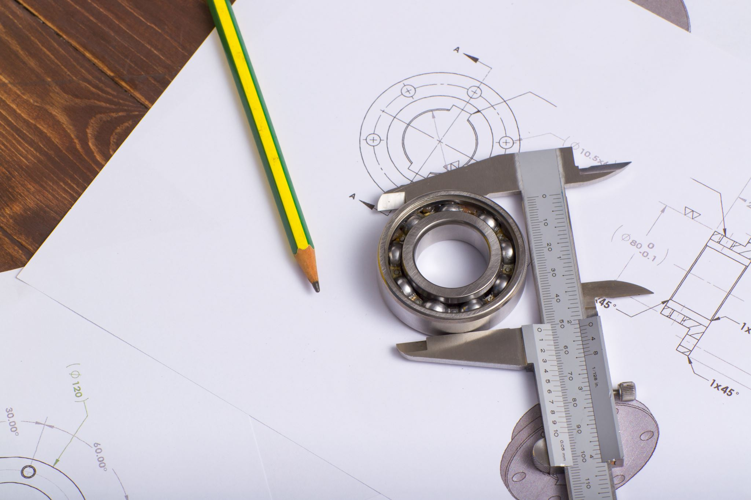
Key attributes: Accuracy and Precision
A process is accurate if the end state of the process is always achieved.
A process is precise if the steps of the process are always followed.
Notes:
We use two key metrics – Accuracy and Precision, similar to statistical analysis you’re probably familiar with.

Slide 7
Documented Process
Notes:
Lets say this is the documented process – and you start interviewing the key users to find out how they actually perform the process.

Slide 8
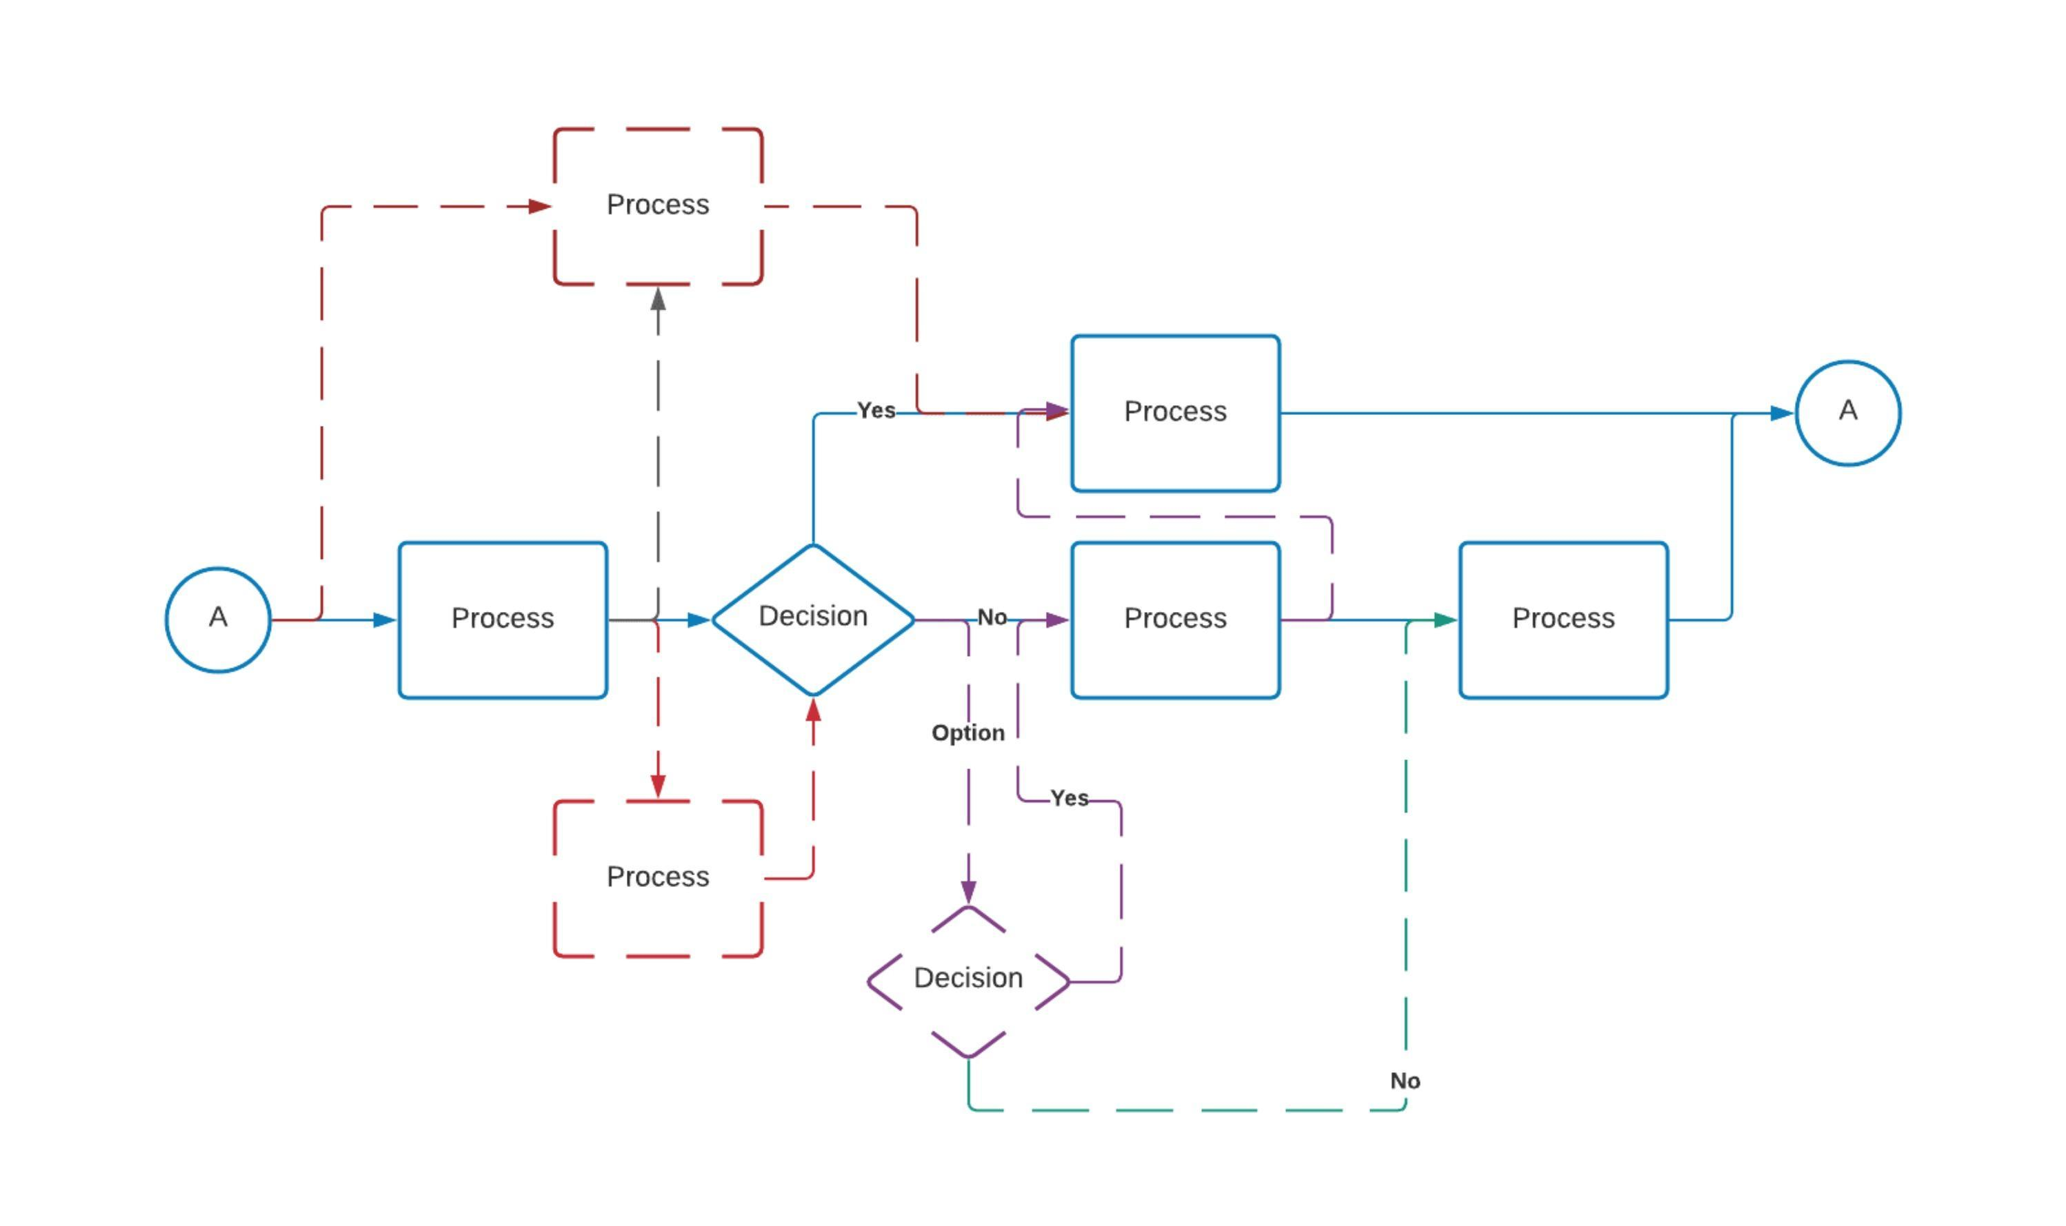
Accurate, NOT precise = too much waste
Notes:
Lots of waste
Usually caused by: - Lack of training leading to too many steps or too many missed steps.
Technology/other external factors making it impossible to follow documentation
OR
Users have found a better way to do it.

Slide 9
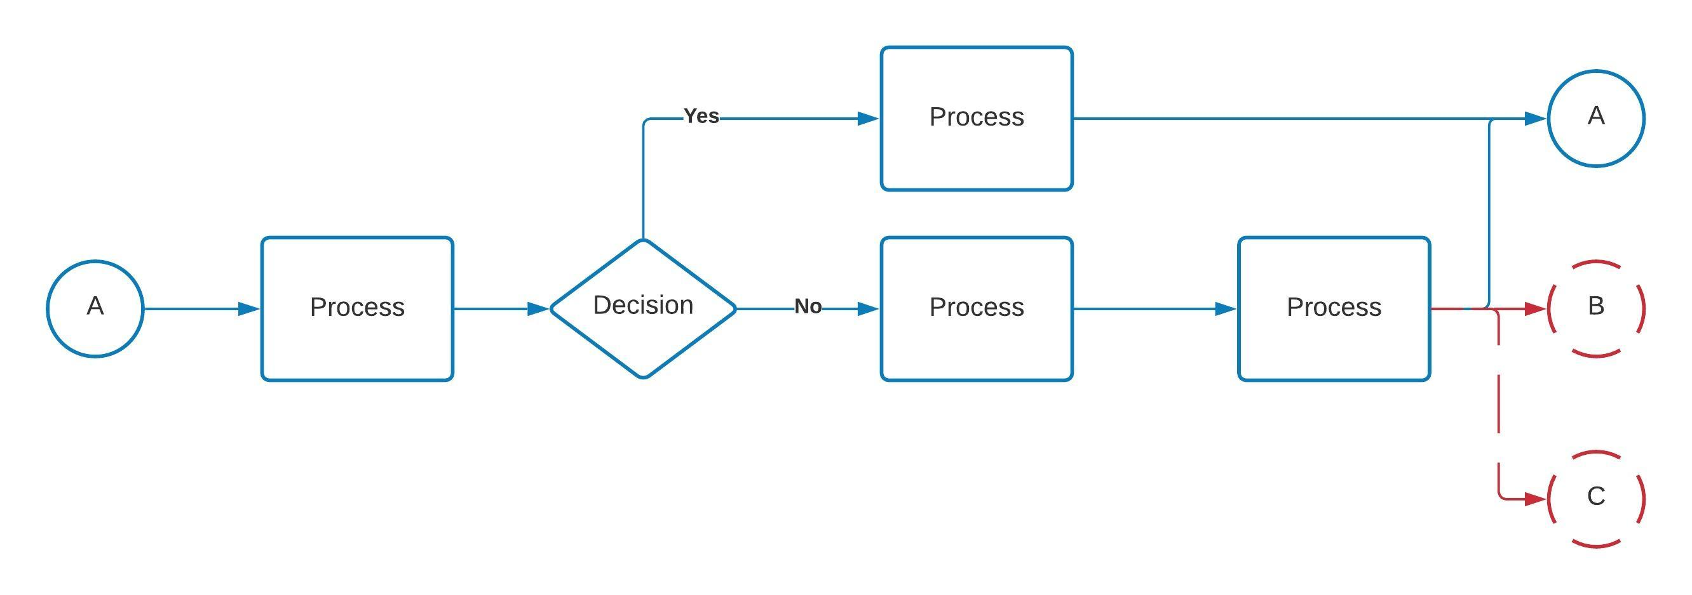
Precise, NOT accurate = too much variation
Notes:
Lots of variation
Causes - Technology allowing too many options
Training
Generic system/data fields
No validation/checklists
OR
The users have a need for multiple outputs but is not reflected in this process.

Slide 10
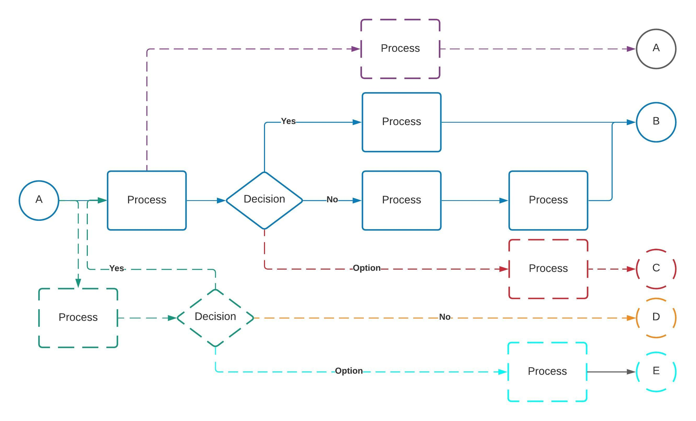
NOT accurate, NOT precise

Slide 11
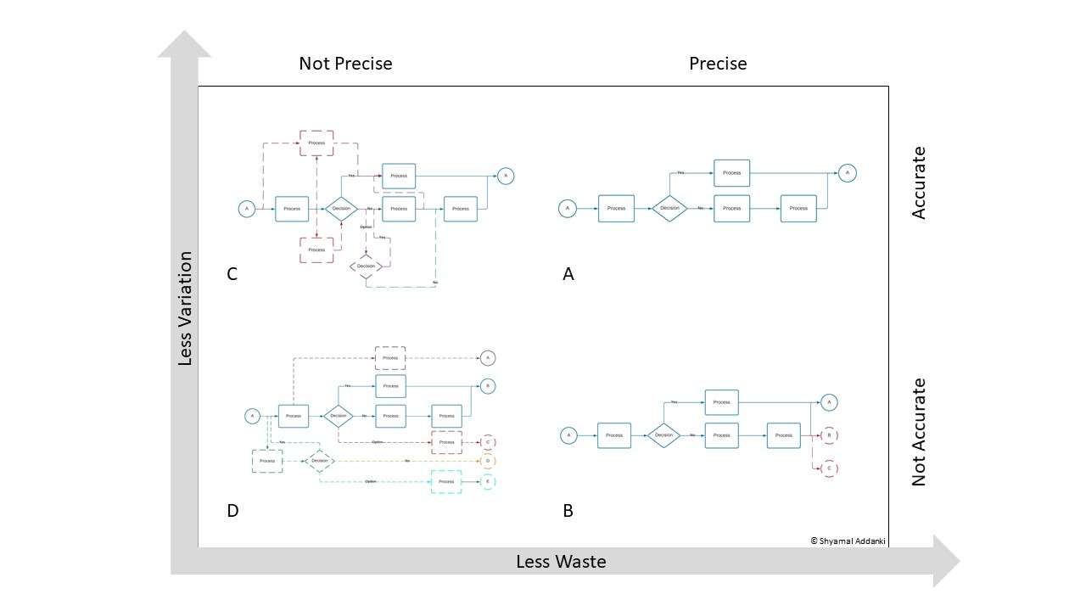

Slide 12
Less Process Risk
Request Purchase Order
Onboard new hire
Request new hardware
Qualify product for manufacturing
Report Performance
Request new software
Approve product design
Request Component Resuply
Greater Process Risk

Slide 13
Types of process risks
Operational: Short-Term Risk
Competitive: Medium-Term Risk
Strategic: Long-Term Risk
The process issues are current and cause daily operational problems.
The processes are not optimized or digitized and impact company profits.
The processes are stable but not scalable for the company’s growth strategy

Slide 14
Quantitative result of a PRA workshop output
Process Number | Process Name | Doc vers | Steps | A score | Final states | P score | Acc Ind | Pre Ind | ST Risk | MT Risk | LT Risk
UG-HR201 | Onboard Employee | 2.6 | 15 | 22 | 1 | 1 | 0.533 | 1.000 |  | X
UG-HR236 | Approve Vacation Request | 1.2 | 7 | 9 | 2 | 3 | 0.714 | 0.500
UG-HR277 | Review Employee Performance | 3.4 | 4 | 3 | 1 | 1 | 0.750 | 1.000 | X | X
UG-PR734 | Accuire New Component | 3.1 | 14 | 17 | 2 | 3 | 0.786 | 0.500 | X | X
UG-PR712 | Qualify Suppier | 4.2 | 17 | 12 | 3 | 2 | 0.706 | 0.667 | X |  | X
UG-EN102 | Design Harness Installation | 7.2 | 39 | 57 | 1 | 1 | 0.538 | 1.000 | X | X
UG-EN132 | Design Harness Assembly | 8.3 | 25 | 39 | 3 | 4 | 0.440 | 0.667 | X | X
UG-EN167 | Configure Engineering Model | 3.3 | 9 | 5 | 5 | 2 | 0.556 | 0.400 | X | X | X
UG-EN138 | Release Engineering model | 4.5 | 15 | 29 | 2 | 1 | 0.067 | 0.500 | X | X | X
UG-CM432 | Review Change Requests | 3.4 | 18 | 12 | 3 | 2 | 0.667 | 0.667 | X | X
UG-CM417 | Schedule Design Change | 5.2 | 16 | 22 | 1 | 1 | 0.625 | 1.000 | x |  | x

Slide 15
Example of a PRA Matrix plotted

Slide 16
Which process should we pilot for DT?

Slide 17
Further considerations for Digital Transformation
Process Documentation
Is the process well documented and understood? If you ask five different users to explain the process, will you get the same answer from all five?
Process Complexity
Is this a linear process, or are there a lot of logic gates and decisions? How often does the process loop back or connect to other parts of the process? How many points of human input does the process have, and are they quantitative or qualitative?
Process Lifecycle
How long does one execution of the process run?
Process Importance
How critical is this process to the core business activities?
Process Integrations
Does this process integrate with up- or down- stream activities?

Slide 18
Which kind of automation?
Task
RPA: Robotic Process Automation
BPA / DPA: Business / Digital Process Automation
Automate repeatable user tasks
Standard UI, no system connections required
Quick to deploy across an organization
Not aligned with business process or tasks
No links to upstream or downstream activities
Replace end-to-end process with automation
Design, analyze, execute, monitor and optimize
Connects to other systems via adapters and APIs
User tasks can be assigned and managed
Aligned but not linked to process documentation
Where does AI fit in Digital Transformation and Process Automation?
Workflows
BPM: Business Process Management
Replace automatable process steps
Connects to other systems via APIs
User tasks can be assigned
Usually exists within systems
Not aligned with process documentation
No links to upstream or downstream activities
Includes all BPA features
Integrated process modelling and documentation
Robust process governance and change management
User role and organization management
Standardized BPMN 2.0 notation

Slide 19
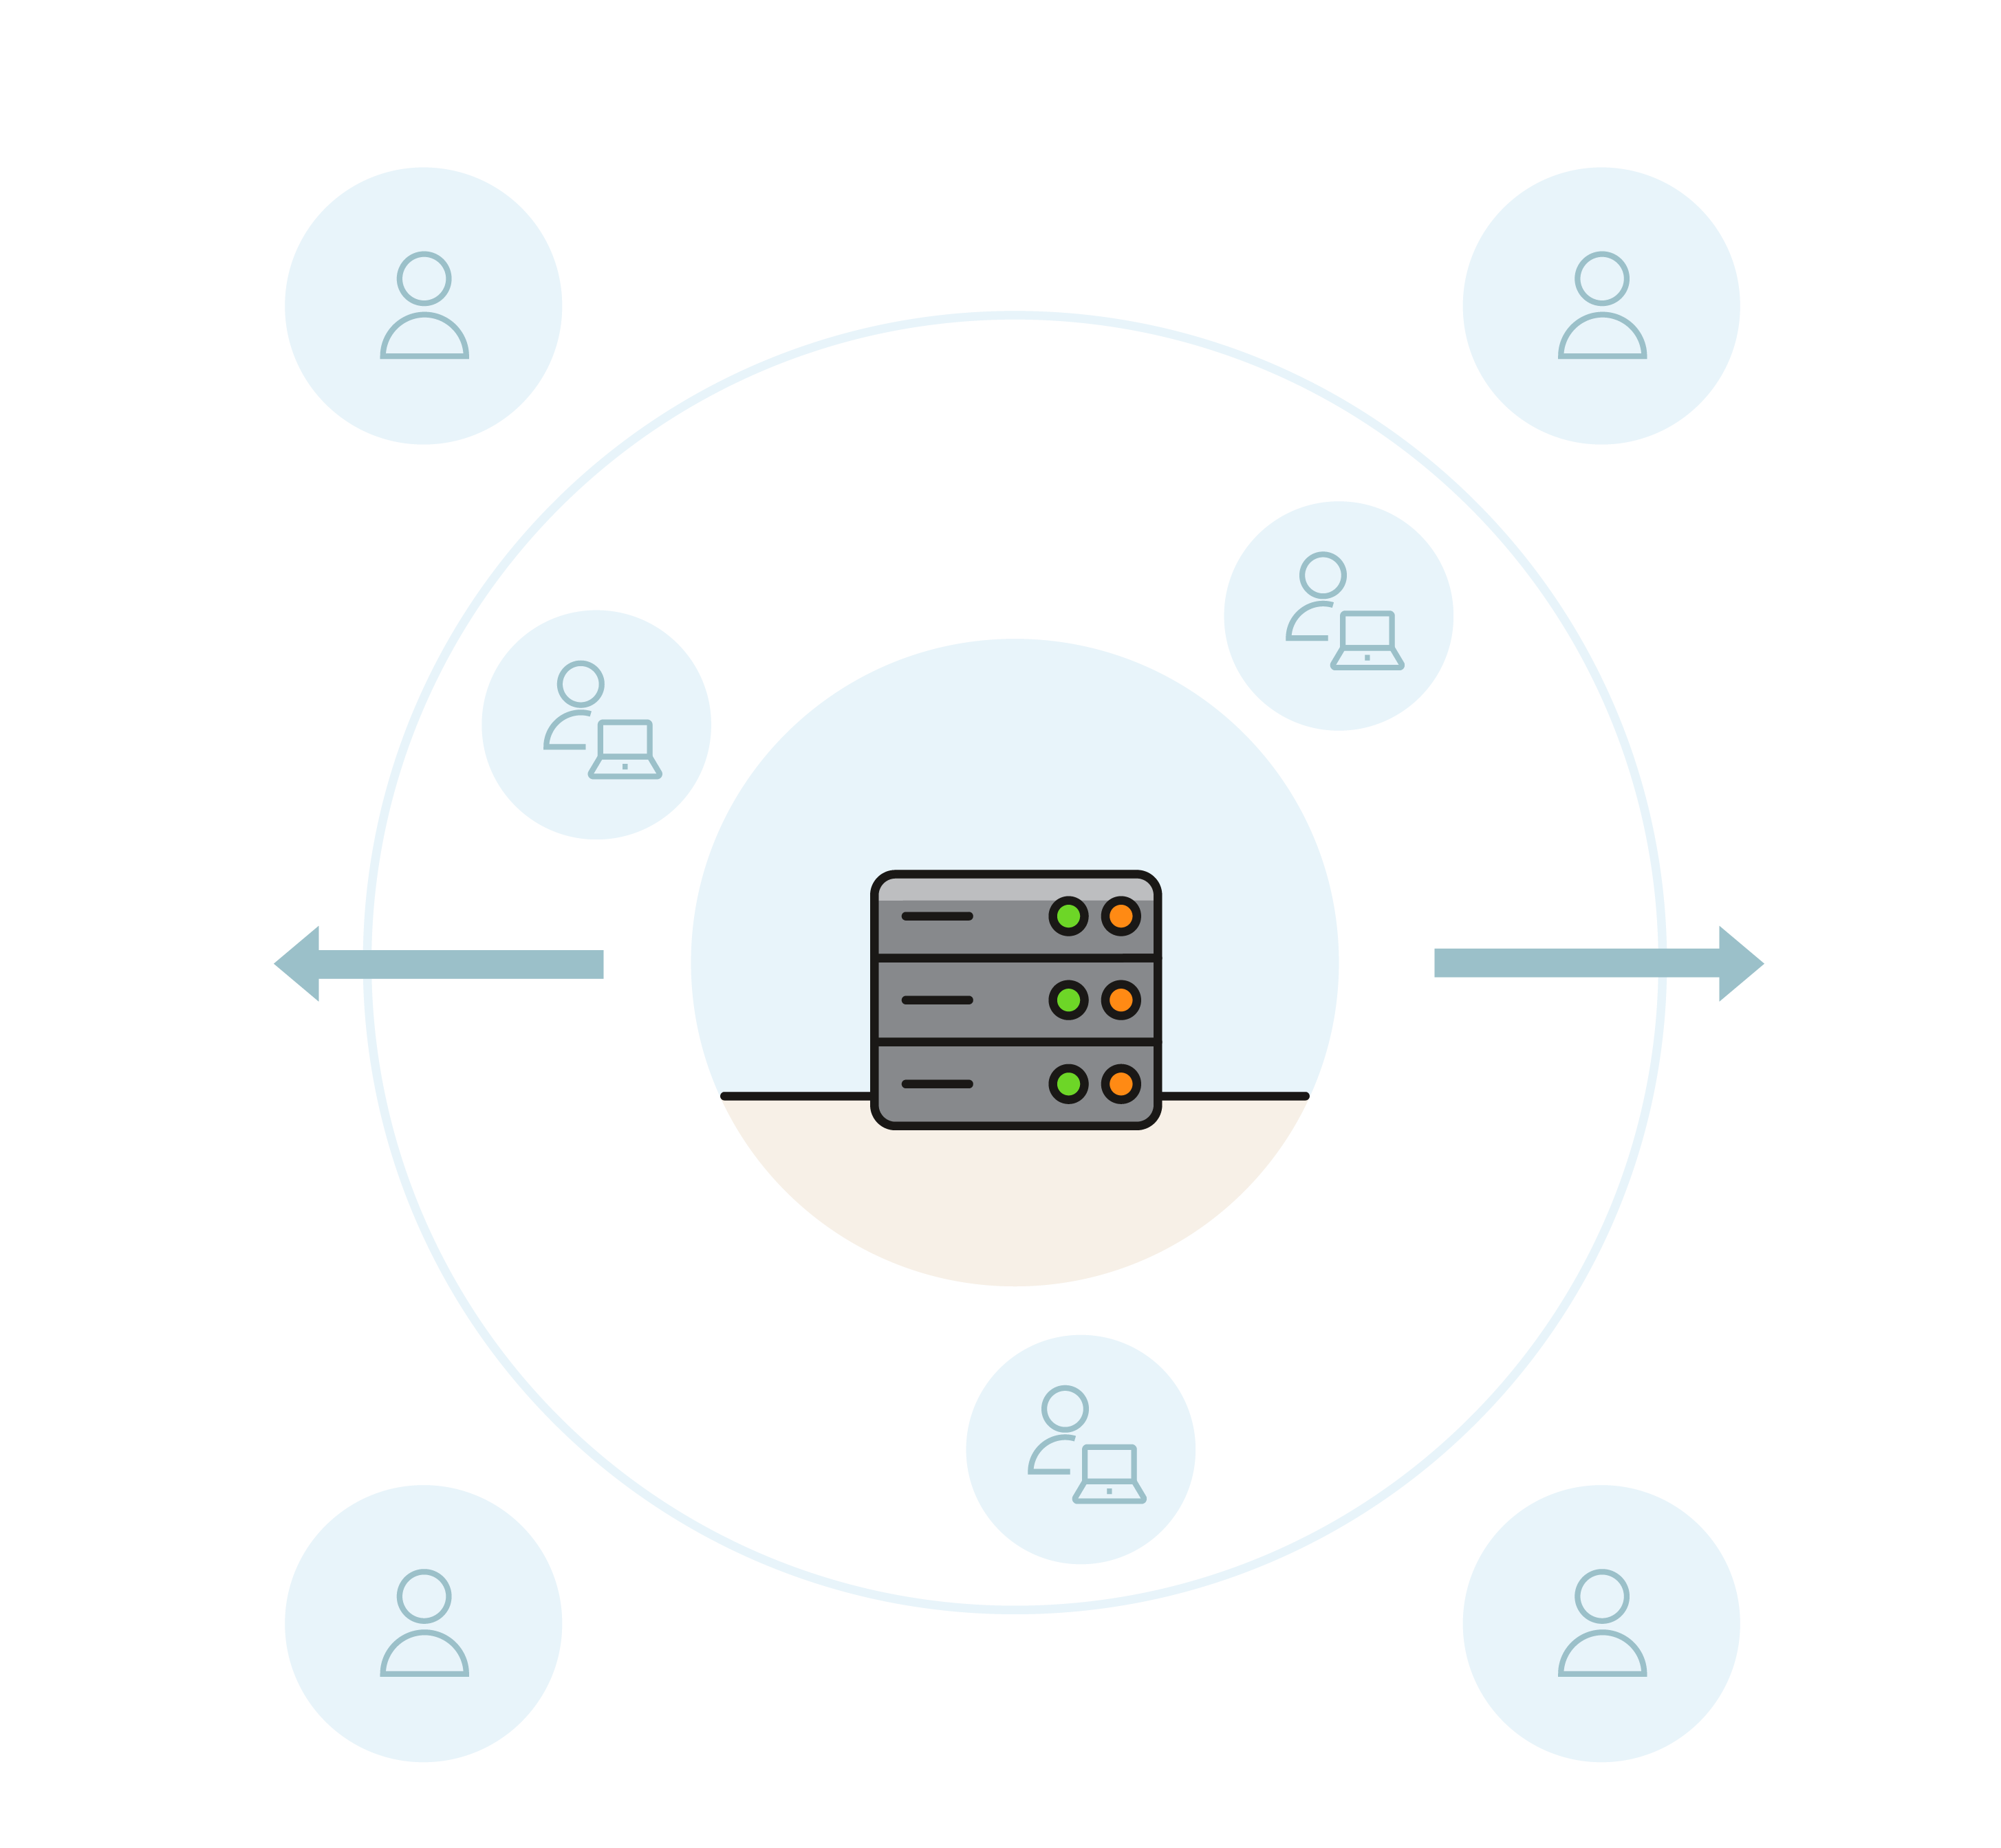
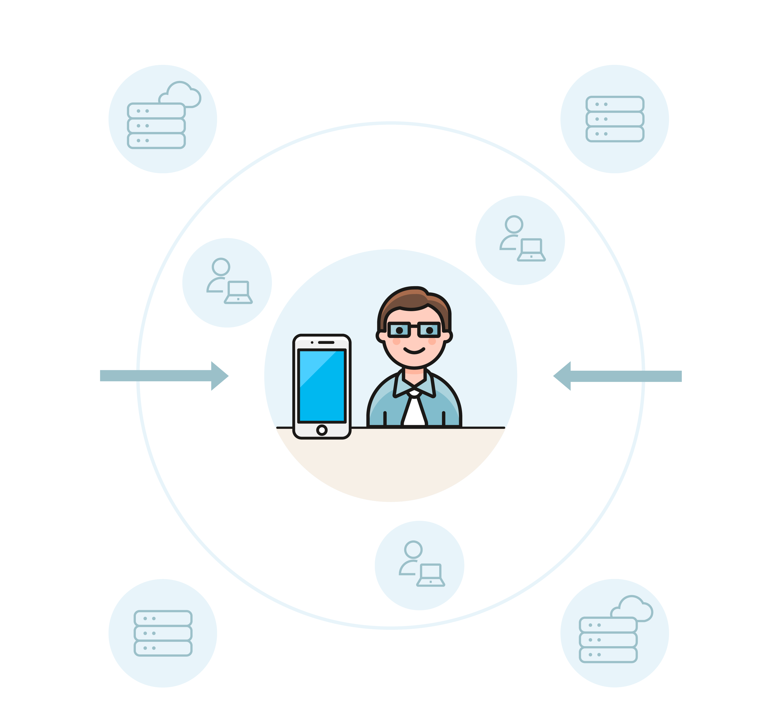
Traditional enterprise software focuses on a system-first approach to processes.
Focus instead on a user-first approach to technology.
Digital Transformation
Past: Process follows IT
Future: IT follows process
Process-driven automation
Focus on user journey
Process monitoring
Digital Workspace
Process Risk Analysis

Slide 20
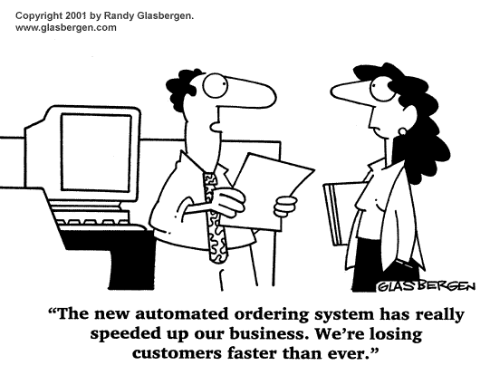
Summary and Parting Thoughts
Before investing in digital transformation technology, get to know your processes.
Not all shortcuts are bad. If users are circumnavigating a process, find out why.
Process Risk Analysis should be a regular exercise and general trends should be observed.
Long term risks should be discussed with CxO for strategy planning.
Add PRA to your Six-Sigma “Analyse” phase.

Slide 21
Q&A
Shyamal Addanki
shyamal@silvermistconsulting.com

Slide 22
Thank you!
Shyamal Addanki
shyamal@silvermistconsulting.com

