Slide 1
Size Does Matter Learn how to reduce your content footprint to save costs
Andy Lavender
AIIM Oil & Gas SIG Leader

Slide 2
Agenda Why are we here?
Introduction
Meeting Etiquette
Content Footprint
How big is the footprint?
What can we do about it?
What are the benefits?
What are the risks?
Questions to consider

Slide 3
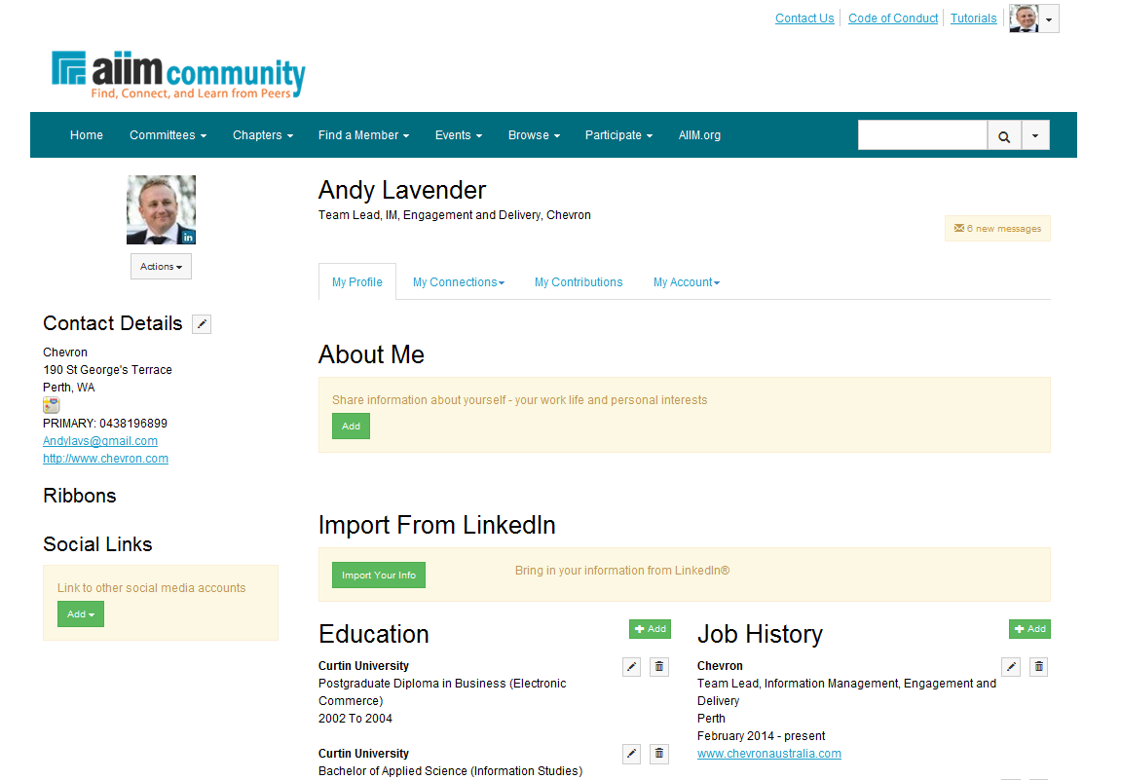
Introduction Who am I?

Slide 4
Web Conference Call Success Meeting Etiquette
Please select mute to remove any background noise
If you have any questions please raise your virtual hand
Feel free to participate in any online polls

Slide 5
How big is the footprint?
Exponential data growth is the primary IT challenge facing oil, gas and energy enterprises today.
A relatively, manageable 50 terabytes (TB) today, growing at a modest rate of 30%, becomes nearly 110 TB in three years.
Seven short years later, it’s almost 700 TB.
That’s a 1,378% increase and an enormous amount of data to manage.
Source: Shahbaz, Ali. (2013) Key considerations for managing unstructured data. Retrieved from http:///www.pipelineandgasjournal.com

Slide 6
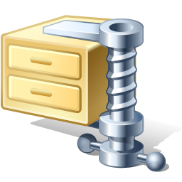
What can we do about it? Reduction Strategies
Classify files and archive or dispose per records retention
Implement quotas (file size restrictions)
Compress your data
Implement file type restrictions
Configure maximum version settings

Slide 7
What are the benefits?
Controlled content growth and storage costs
Reduced legal exposure and e-discovery costs
Improved findability
Decreased migration effort for system upgrades

Slide 8
What are the risks?
Breaking retention cycles, legal holds, preservation orders
Restricting collaborative practices
Confusing information users
Business participation

Slide 9
Questions to consider
Is reducing the content footprint a critical
activity for your business?
Do you have an idea about how much the
footprint is costing you?
Are there any other reduction initiative's
you would like to share?
Which unstructured information repository has the biggest challenges around storage?
?

Slide 10
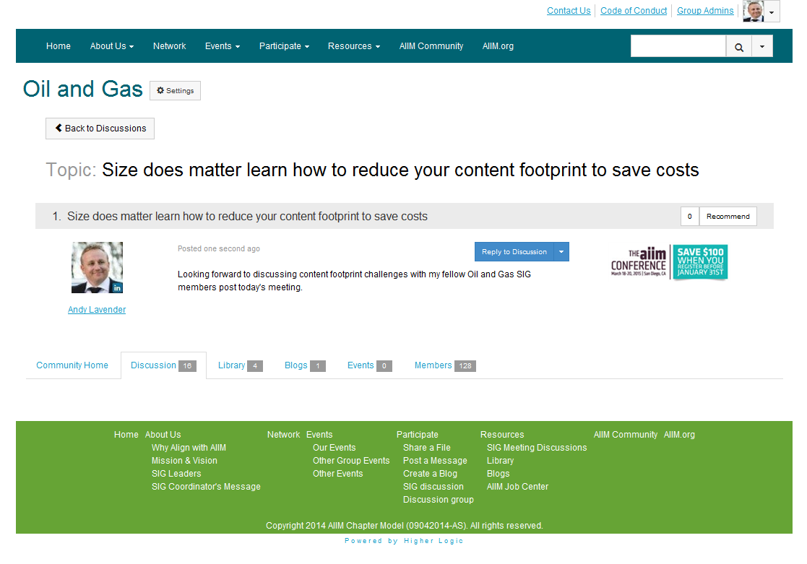
Let’s continue the conversation

