Slide 1
How to implement ERM?
Atle Skjekkeland, Vice President, AIIM
Carl E. Weise, CRM, ERM Master, AIIM
Global best practices for implementing Electronic Records Management (ERM) using ISO/TR 15489-2

Slide 2
ISO 15489-2 implementation methodology
Conduct preliminary investigation
Analyse business activity
Identify requirements for records
Assess existing systems
Identify strategies to satisfy requirements
Design records system
Implement records system
Conduct post-implementation review

Slide 3
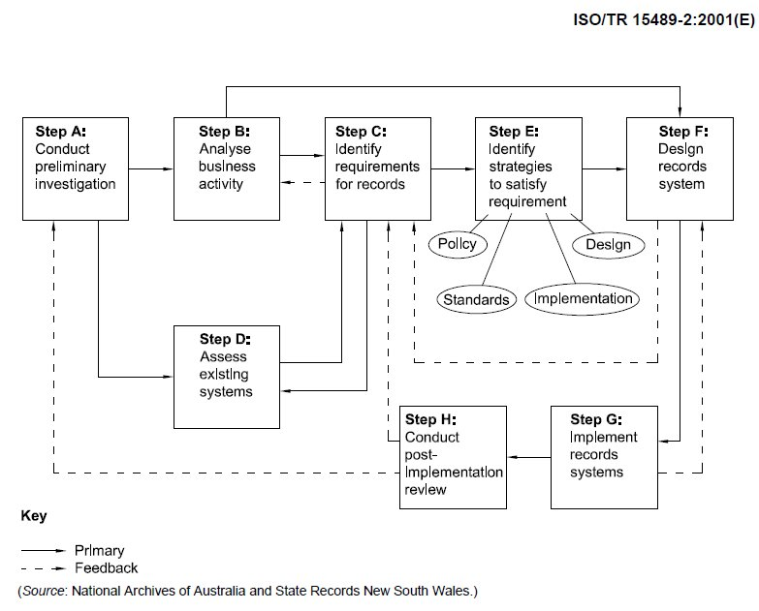
ISO 15489-2 framework illustrated

Slide 4
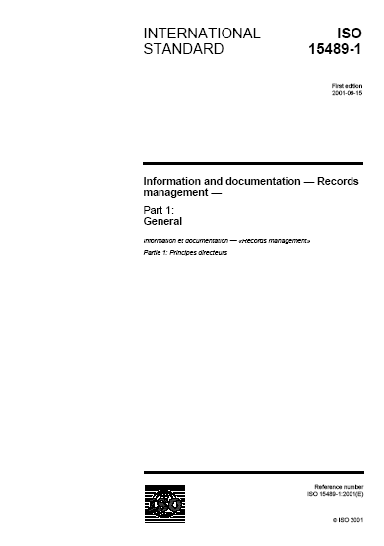
Step A – Conduct preliminary investigation
Initial assessment of organisation’s legal and business environments
Identification of records-related challenges
Results in defining scope of the
programme and the programme
charter

Slide 5
ERM implementation & the organisation
Ensure integration with other initiatives
Before the ERM implementation programme begins, there must be:
Good project management
Appropriate team composition
Adequate resourcing
Identified early benefits ('quick wins')

Slide 6
Programme charter
Formally authorises the programme to begin
Issued by the programme sponsor
Grants project managers authority to commit resources to the programme and the projects
Sometimes called a Concept of Operations or Project Initiation Document
Shows a vision that is aligned to the business strategies and realities

Slide 7
Programme goals and scope
Programme goals
Identify need for change and reasons
Identify objectives of the project
Programme scope
Items and areas in scope
Items and areas not in scope
Programme benefits

Slide 8
Strategic information alignment framework
Marchand’s Strategic Information Alignment Framework
Add value
customers and markets
Minimise Risks
market, financial, legal,
operational risks
Reduce Costs
transaction and
processes
Create New Reality
Intelligence (social, political, technological, etc)
Source: “Competing with Information,” Donald Marchand (2000)

Slide 9
Critical success factors (CSFs)
What is required for the programme to succeed
Common CSFs for an ERM programme:
Senior management support
Proper planning and commitment
User involvement
Education and training
Ease of use (system and processes)

Slide 10
Key performance indicators (KPIs)
Statistics that need to be captured to measure and manage success or failure relating to CSFs
Measurable and meaningful metrics
Owned by senior manager
Responsible for meeting targets
Takes corrective action
when required

Slide 11
Risks, constraints, and assumptions
Risks
Potential problems that may impact the project
Example: vendor is acquired
Constraints
Conditions that limit the project
Example: resource or technology constraints
Assumptions
Details assumed to be true that impact the project
Example: project will be adequately resourced

Slide 12
Step B – Analyse business activity
Business activity analysis
How the organisation is structured
How the organisation works
Areas of concern
How should work be prioritised
ISO/TR 26122:2008 Information and documentation – Work process analysis for
records
Framework for conducting work
process analysis

Slide 13
Benefits of the assessment
Identify dependencies between processes and/or transactions
Identify records creation requirements
Identify points at which records are created
Identify contextual links between records
Identify opportunities to integrate records capture into the process

Slide 14
Contextual review - 1
Review of the regulatory environment
Statutes, regulations and case law
Mandatory standards of practice
Voluntary codes of conduct/ethics
Organisational rules
and procedures
Community expectations

Slide 15
Contextual review - 2
Review of the organisational context of the work processes
Identify the work processes within the organisation
Identify the nature of the processes
Identify accountabilities for the processes
Describes framework for mapping functions, processes/activities and transactions

Slide 16
The assessment process - 1
Gather information about as-is processes
Develop top-down functional decomposition – functions, processes, tasks, and transactions
Perform bottom-up task and transaction analysis – triggers, steps, sequencing, dependencies, variations and exceptions

Slide 17
The assessment process - 2
Validate analyses with users; determine best practices
Identify points of record creation, process dependencies, and information requirements (data, content, and metadata)
Analyse present organizational awareness
Records management principles
The existing records programme (if any)

Slide 18
Step D – assessment of existing systems
Identify all applications in use throughout organization
Determine which applications create, capture, and/or manage records
Evaluate security and access controls
Evaluate controls to ensure record
authenticity, reliability, integrity, and usability

Slide 19
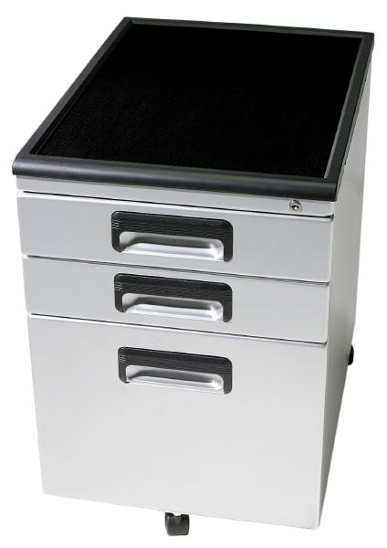
Identify system gaps in RM capabilities
Required records control framework
Support for classification and retrieval
Support for metadata and metadata standards
Retention and disposition
Support for litigation holds
Audit trails

Slide 20
Strategy and planning projects
Conduct business assessment
Conduct technology
assessment
Develop business case
Develop programme
roadmap

Slide 21
Records management projects
Inventory information assets
Identify records
Develop records management policy
Develop taxonomy
Develop a metadata model
Develop records retention schedule
Develop records management processes and procedures

Slide 22
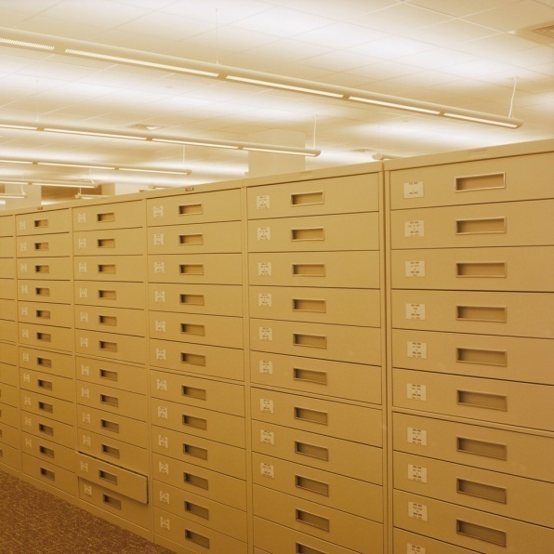
Vital records and archives projects
Identify vital records
Develop vital records processes and procedures
Identify archives
Develop archival
processes and procedures

Slide 23
ERM technology projects
Identify ERMS requirements
Design ERMS
Procure ERMS
Implement ERMS
Integrate ERMS into line of business applications

Slide 24
Other projects
Develop migration plan
Develop litigation support plan
Conduct “shred day”/organisational cleanup
Design and deliver
training
Monitor and audit
Identify and implement
programme updates

Slide 25
Step C – Identify requirements for records
Business and systems requirements:
Capture the needs of business stakeholders in a manner which enables successful programme outcomes
Statement which identifies a capability, feature or qualitative attribute which has business value for the user

Slide 26
How to produce ERM requirements
Gather and document stated requirements
Separate realistic requirements from stated requirements
Document the reason and rationale for requirements
Prioritise requirements (M,HD,D)
Keep users and stakeholders involved at all stages !

Slide 27
Standard ERM requirements specifications
Developing your own business and functional requirements specification is a significant investment of time and resources
Standard requirements specifications often save effort
Limitations of standard requirements specifications
Benefit of limiting “fine tuning”

Slide 28
Requirements for ERM
Can be grouped into five areas:
Create
Maintain
Disseminate
Administer
Non-functional requirements
From ICA’s guidelines

Slide 29
Step E – satisfying records requirements
Determine the policies, standards, and tactics required for effective records management
Dependent on organisation’s particular requirements and environment
Results in records management
governance framework

Slide 30
What is governance?
Accountability for organisation’s information assets
Ensures compliance with regulations and legislation
Enables productivity improvements
Enables organisation to
respond to change
Sustains good information management practices
Looking
after
Information
properly

Slide 31
The information governance framework
Policies
Procedures
Standards
People
Tools & Technology
Audit

Slide 32
Implementing the framework
Policy
Processes and standards for managing records
Management
Governance roles and responsibilities
Organisation
Groups and structures required to manage information

Slide 33
Step F – Design of a records system
Design processes, tools, and systems required to implement the programme
How to combine the policies, processes, systems, and standards to satisfy the requirements

Slide 34
Process design principles
Identify required process changes
Requirements
Organisational factors
Take iterative approach

Slide 35
Assign ERM roles and responsibilities
Individual users or specialists
Roles
Work groups or processes
Across the organisation
Management
Automation
Monitoring

Slide 36
Design work processes
Design new processes required to manage records
Creation and capture
Classification
Search and retrieval
Retention and disposition
Update existing work processes
to incorporate records management

Slide 37
Technology system design
Starts with requirements document
Recordkeeping requirements
Other business and functional requirements
Platform-specific requirements
Ensure that design meets
all mandatory requirements
Includes interfaces, architecture,
inoperability and security

Slide 38
Step G – Implementation of records system
Develop and implement the solution
Develop solution per design
Test and pilot the solution
Prepare local areas for implementation
Implement the solution
Go-live

Slide 39
The model office
Use to develop policy and procedures
Use to draft training on new policy and procedures
Test bed for ERM
processes and
instruments
Not real world

Slide 40
The pilot
Used to validate (or draft) policy and procedures
Used to validate new processes
Used to validate technology solution
Used to validate efficacy of training
Reflects real world requirements

Slide 41
Benefits of the model office and pilot
Minimize rework
Identify and address problems before the programme is rolled out to everyone
Promote user acceptance and goodwill towards new ERM programme
If the pilot is not meaningful, it could backfire

Slide 42
Generic outline plan
ERM programme design
ERM technology solution design
ERM technology implementation
Support development
Training development
Data migration
System testing
User acceptance testing
Local preparation
Training
Pilot
Go live
Communication

Slide 43
Planning for change
Change does not happen overnight
Users may try to “wait out” change
Change requires effort over time
Changed behaviours must
become habits

Slide 44
Step H – post-implementation review
Measure effectiveness of records system
Evaluate system development process
Establish monitoring regime
Anticipate changes to
organisational needs and the
records management environment

Slide 45
What needs doing?
Development of records management across the organisation
Ensuring take-up & effective use of ERM
Extending the scope of ERM
To new areas or new types of content
To new processes and applications
Assessing new developments which create records

Slide 46
Benefits management
Take corrective action if benefits do not materialise
Identify the cause
Unclear procedures and processes
User training not effective
Identify possible cures
User interface improvements
Removal of alternatives

Slide 47
Continuous improvement
Organisations do not generally go from no RM programme to world-class in one iteration
Scope issues
Change management issues
Some opportunities for improvement will remain
Solicit feedback from stakeholders

Slide 48
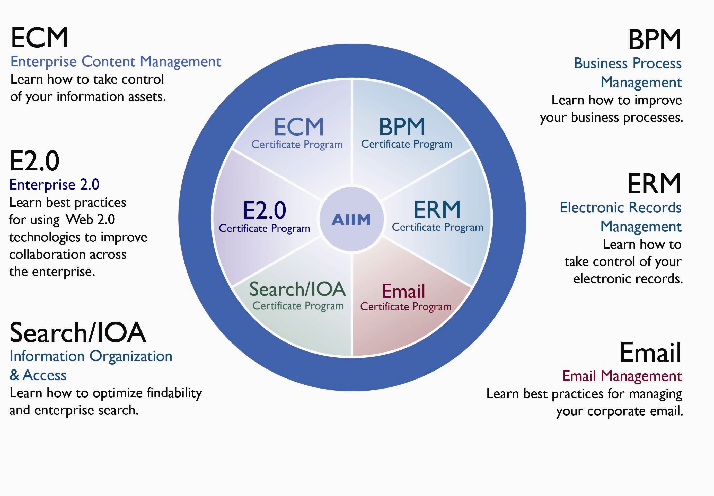
AIIM ERM Specialist and Master Program - learn how to impl. ERM
www.aiim.org/training

