Slide 1
OVERWHELMED & OVER IT! Transforming Stress & Pressure into Balance & Personal Power a feminine leadership session with christine arylo for aiim
www.aiim.org

Slide 2
Like you,
I am a strong woman
“I believe that I have the potential to do and be anything.
I can get a lot done in a day. I have accomplished a lot. I have met the curve balls life has thrown me. I still have dreams. I desire to make an impact.
And … “

Slide 3
“No matter how much I do, work, and give, it’s never enough. There’s not enough time, money, resources, space, help…I am over stretched, under supported and I just can’t do it all anymore.
I quit!”
I am also susceptible to the “Super Woman Sob”

Slide 4
It is NOT our fault.
And we are the only ones
with the power to change it.
Together.

Slide 5
Today
Wisdom behind why it’s not your fault – you can’t change what you can’t see & our traditional trainings and education are not giving us the whole picture.
A different way to live and lead – let’s get beyond the trap of work/life balance! You are going to love this feminine wisdom.
Self-created overwhelm – here’s where we find the power to elevate out of overwhelm. This is so empowering, illuminating, and self-revealing.
Recipe for resilience – we really do need super powers to stay centered, clear and calm within the swirl of this fast paced, intense, ever-changing world.

Slide 6
WHY Do We?
Feel overwhelmed?
Push ourselves so hard?
Keep burning ourselves out?
Struggle to find work/life balance?
Find it hard to relax, rest and slow down?
Feel so much pressure to keep it all together?
Sacrifice our personal wellbeing for work & others?
Not have the time, money, resources, support we need?
Feel no matter how much we do, we are never doing enough?

Slide 7
ONE: The systems were built for burnout. Humans created the systems, so we are the ones
to change them.
TWO: Your Internal Operating System is programmed to OVER work & give – so you can’t stop sacrificing yourself
or doing & giving too much.
THREE: Your nervous system isn’t conditioned for the pace, intensity & volume of info. And you haven’t been given the tools to strengthen it.
FOUR: The same old solutions don’t have the power needed now –
self-care tips, stress mgt,
work/life balance are not enough.

Slide 8
Why Work/Life Balance Doesn’t Work
A “duality reality” that creates an internal tug of war – with work over life, 50/50.
Balance = static. Our lives are dynamic.

Slide 9
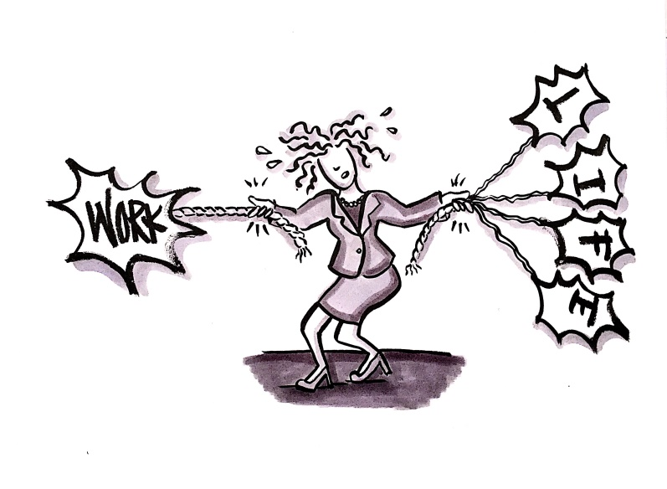
YOU HAVE THE POWER
to make shift happen
Shift your focus from
“Maintaining Work/Life Balance”
To “Cultivating Your
“Feminine Super Power of Harmony”
Super Power #1

Slide 10
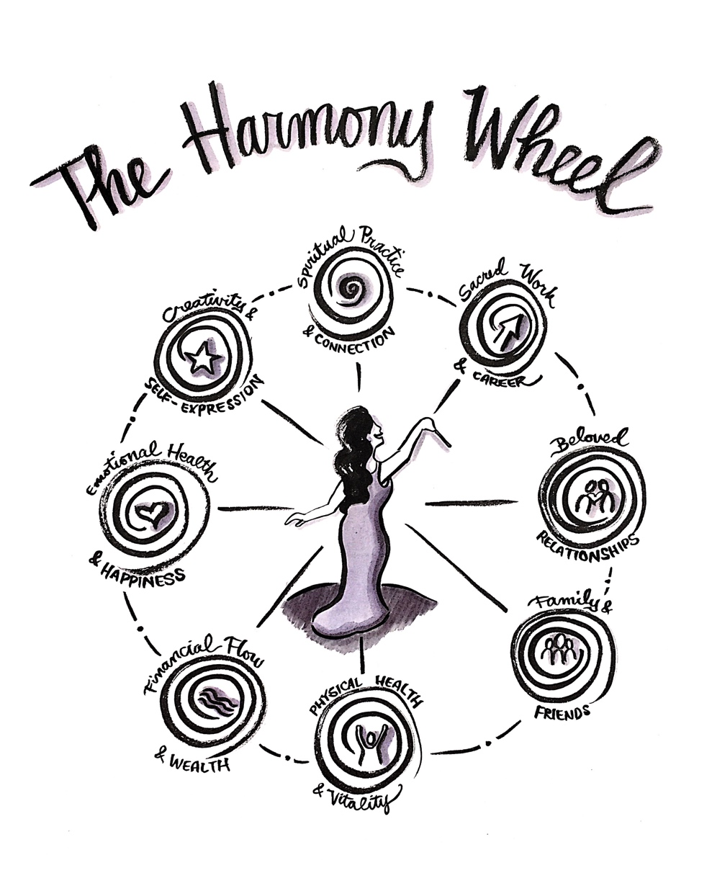
8 Realms of a Dynamic Life
Stand (not juggle) in the Center –
powerful, graceful, centered in Self
Connected To All not Carrying It All.
Focused not Fragmented.
Fluid not Frenzied.
Flowing in Harmonious Rhythm – Intensity + Sustainability + Resting

Slide 11
What is in Harmony?
What is Out of Harmony?
What is Calling
for My Attention now?
What Could Go
onto Maintenance Mode
for a month?

Slide 12
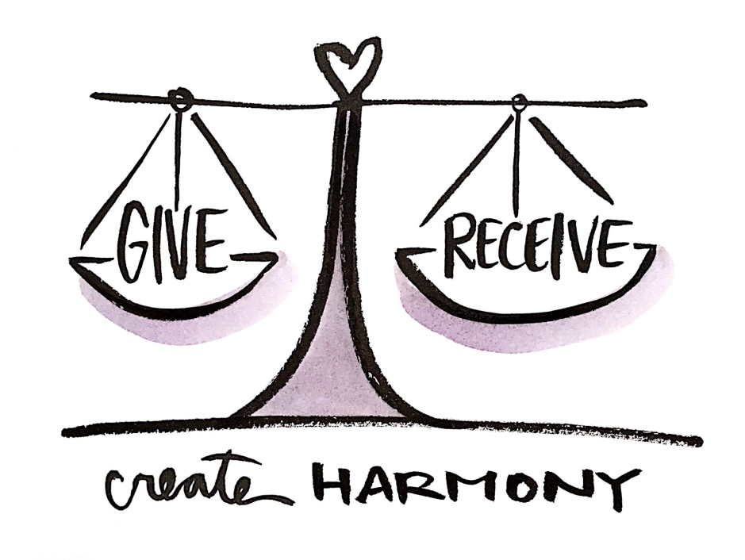
YOU HAVE THE POWER
to make shift happen
Get Your Giving & Receiving into Harmony. Stop Bankrupting & Overextending Yourself. Get Real About Why You Sacrifice Yourself.
Super Power #2

Slide 13
The 9 OVERS
What OVERwhelm program is running
your internal operating system…driving you to over give, under receive, and bankrupt your life force & resources and burnout?
1. Over-caring
2. Over-compensating
3. Over-controlling
4. Over-doing
5. Over-giving
6. Over-working
7. Over-focusing (on future)
8. Over-protecting (yourself)
9. Over-promising

Slide 14
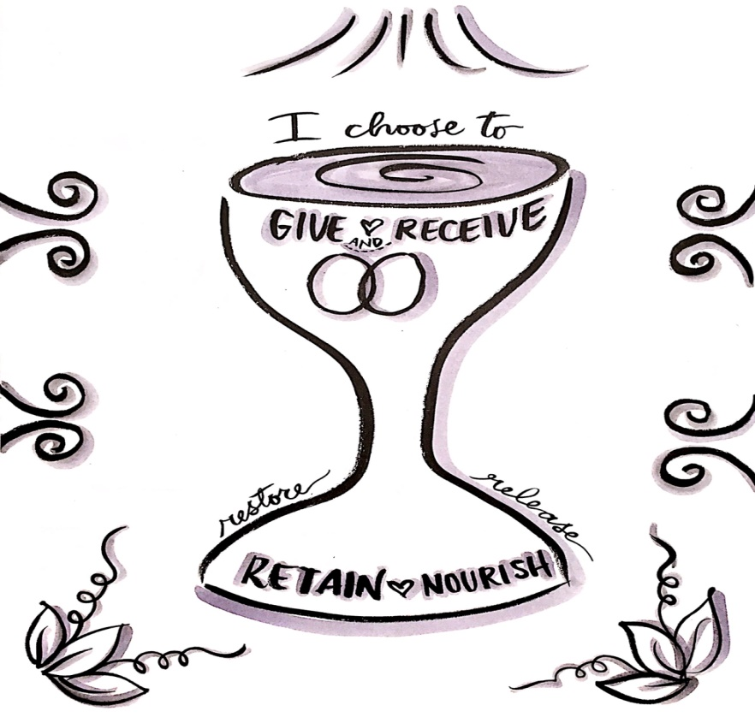
YOU HAVE THE POWER
to make shift happen
Retain Your Life Force.
Receive What You Need.
Super Power #3

Slide 15
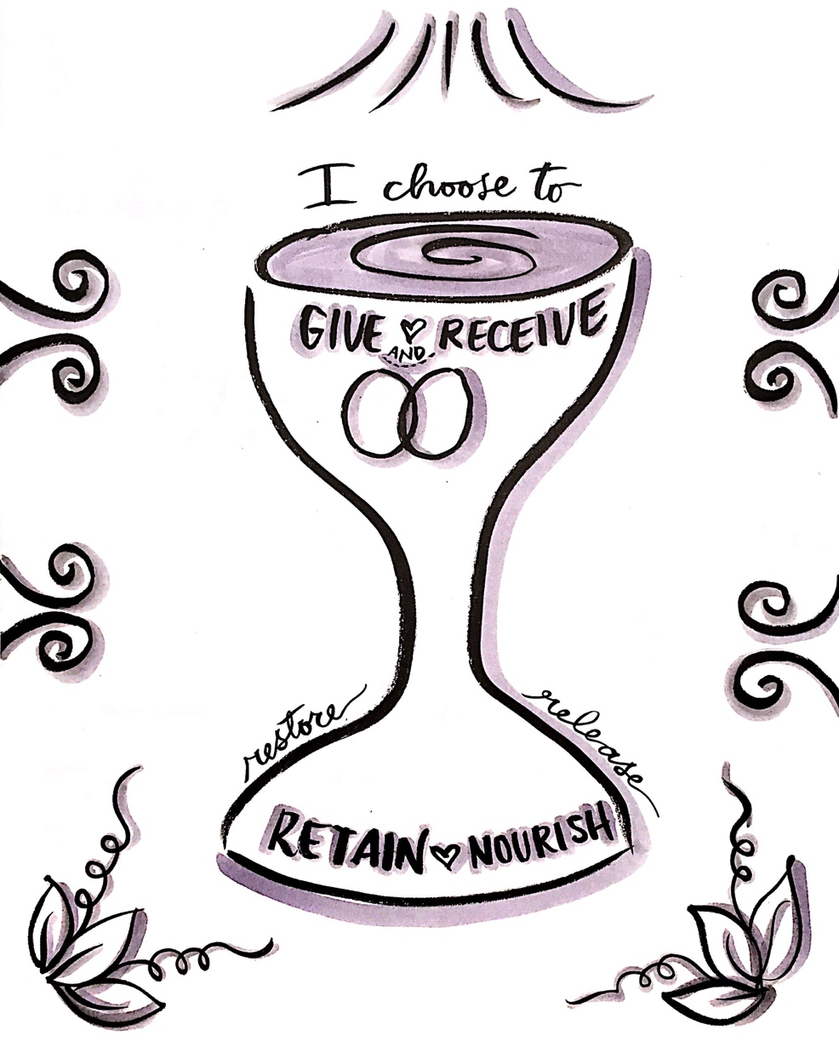
Rule #1: I Never Serve from My Reserves
Rule #2: I Feed the Feminine First
Daily. Every Morning.
During times of Stress.
Morning Harmonizing Practice:
What is My Life Force Level? What Do I Need to Receive?
Overwhelm Elevation Practice:
What Do I Need?
What Would Enough Look Like?

Slide 17
Rule #3 – Never Leave Home Without Harmonizing Yourself First
If you start connected to yourself, harmonized on the inside, you will have the resilience, courage, confidence, and compassion to stay clear, calm and centered on the inside no matter what swirl is going on outside of you.
My Gift to You
Harmonize e-Book: Super Power Practices for Staying Calm, Centered, and Clear within the Swirl of the World
Go to:
www.HarmonizeBook.com

Slide 18
Thank You!
Please join us online at community.aiim.org/wiim
Next webinar will be in August and focus on Leadership and Speaking opportunities at AIIM.

